Slide 1
Lecture -18
Engineering Mechanics
Moment of Inertia

Slide 2
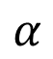
Introduction
The concept which gives a quantitative estimate of the relative distribution of area and mass of a body with respect to some reference axis is known as moment of inertia.
Example: A solid and a hollow cylinder each of radius r slides down in an inclined plane (with out rolling).
Which one will reach the bottom first ?
A solid and a hollow cylinder rolls down in an inclined plane (with out slipping/sliding).
Which one will reach the bottom first ?
$$α$$
The moment of inertia of area is called area moment of inertia or second moment of area.
The moment of inertia of mass of a body is called as mass moment of inertia.

Slide 3
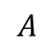
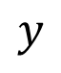
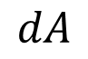
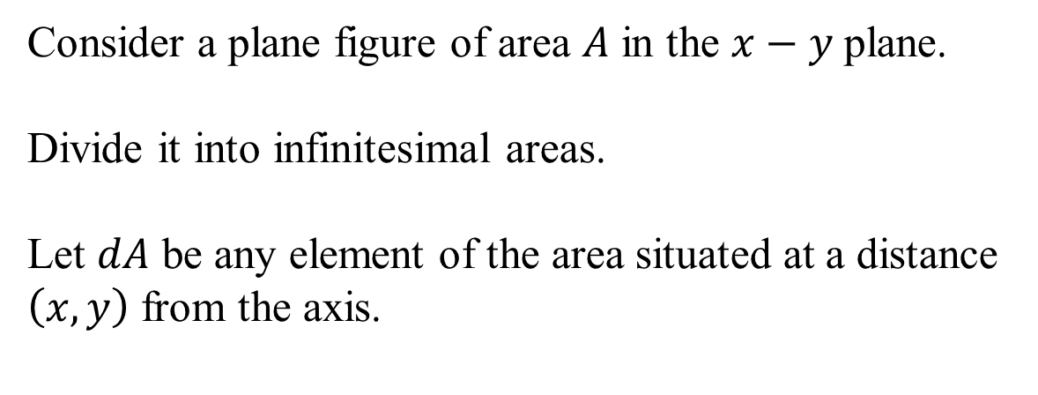
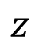
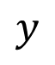
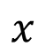
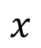
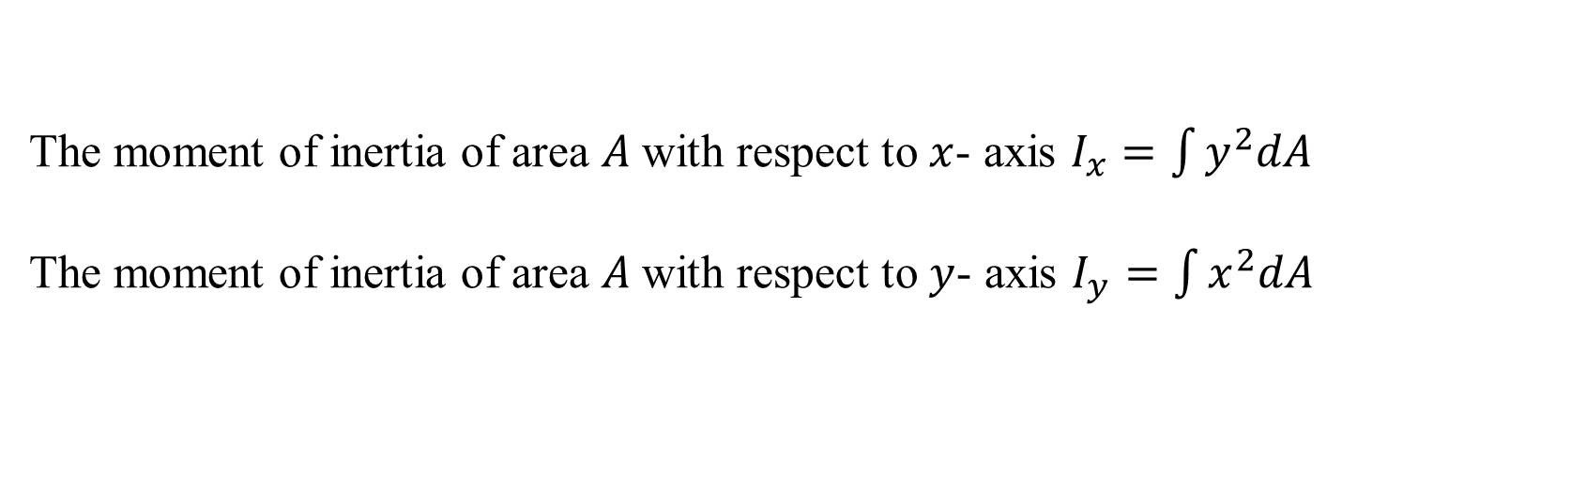
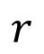
Moment of inertia of area (Rectangular M.I)
$$y$$
Consider a plane figure of area $A$ in the $x−y$ plane.
Divide it into infinitesimal areas.
Let $dA$ be any element of the area situated at a distance $\left(x, y\right)$ from the axis.
$$dA$$
$$x$$
$$A$$
$$r$$
$$y$$
$$x$$
The moment of inertia of area $A$with respect to $x$- axis $I_{x}=\int{y^{2}dA}$
The moment of inertia of area $A$with respect to $y$- axis $I_{y}=\int{x^{2}dA}$
$$z$$

Slide 4
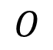
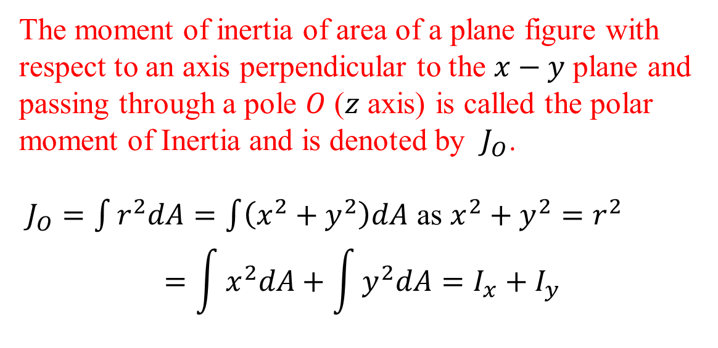
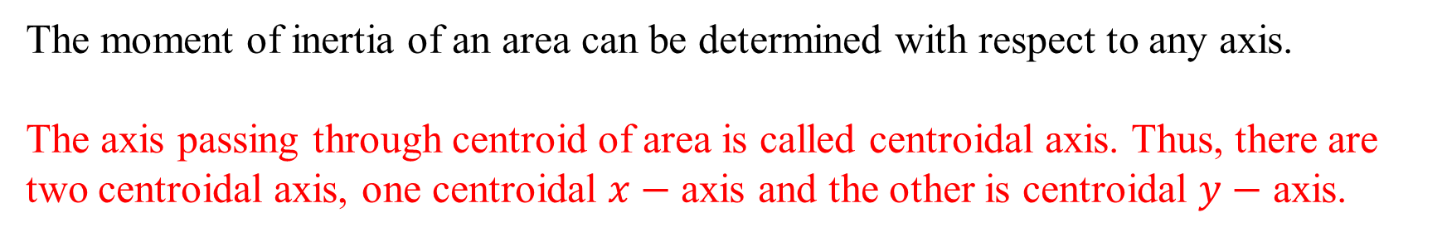
Polar Moment of inertia of area
$$y$$
The moment of inertia of area of a plane figure with respect to an axis perpendicular to the $x−y$ plane and passing through a pole $O$ ($z$ axis) is called the polar moment of Inertia and is denoted by $J_{O}$.
$J_{O}=\int{r^{2}dA}=\int{\left(x^{2}+y^{2}\right)dA}$ as $x^{2}+y^{2}=r^{2}$
$$=\int{x^{2}dA}+\int{y^{2}dA}=I_{x}+I_{y}$$
$$dA$$
$$x$$
$$A$$
$$r$$
$$y$$
$$O$$
$$x$$
$$z$$
The moment of inertia of an area can be determined with respect to any axis.
The axis passing through centroid of area is called centroidal axis. Thus, there are two centroidal axis, one centroidal $x−$ axis and the other is centroidal $y−$ axis.

Slide 5

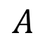
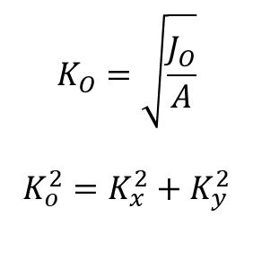
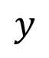
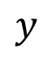

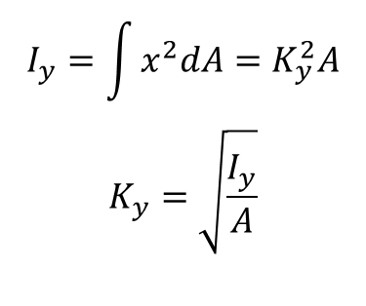
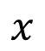
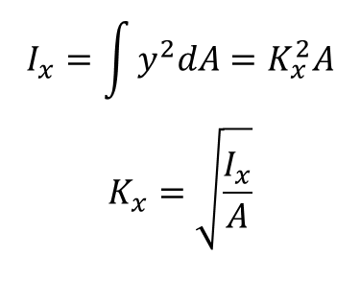
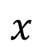
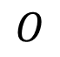
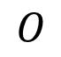
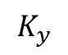
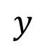

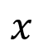
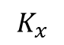
Radius of gyration of an area
$$y$$
$$y$$
$$y$$
$$A$$
$$A$$
$$A$$
$$K_{y}$$
$$K_{x}$$
$$O$$
$$O$$
$$O$$
$$x$$
$$x$$
$$x$$
$$I_{x}=\int{y^{2}dA}=K_{x}^{2}A$$
$$K_{x}=\sqrt{\frac{I_{x}}{A}}$$
$$I_{y}=\int{x^{2}dA}=K_{y}^{2}A$$
$$K_{y}=\sqrt{\frac{I_{y}}{A}}$$
$$K_{O}=\sqrt{\frac{J_{O}}{A}}$$
$$K_{o}^{2}=K_{x}^{2}+K_{y}^{2}$$

Slide 6
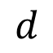
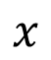
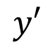
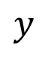
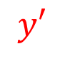
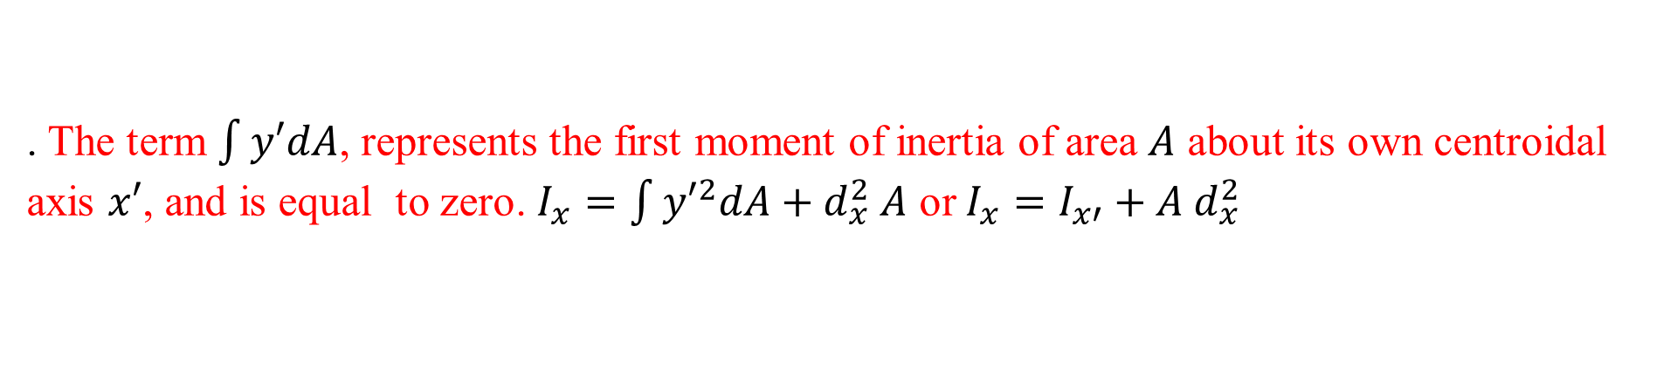
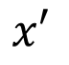

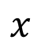
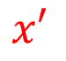

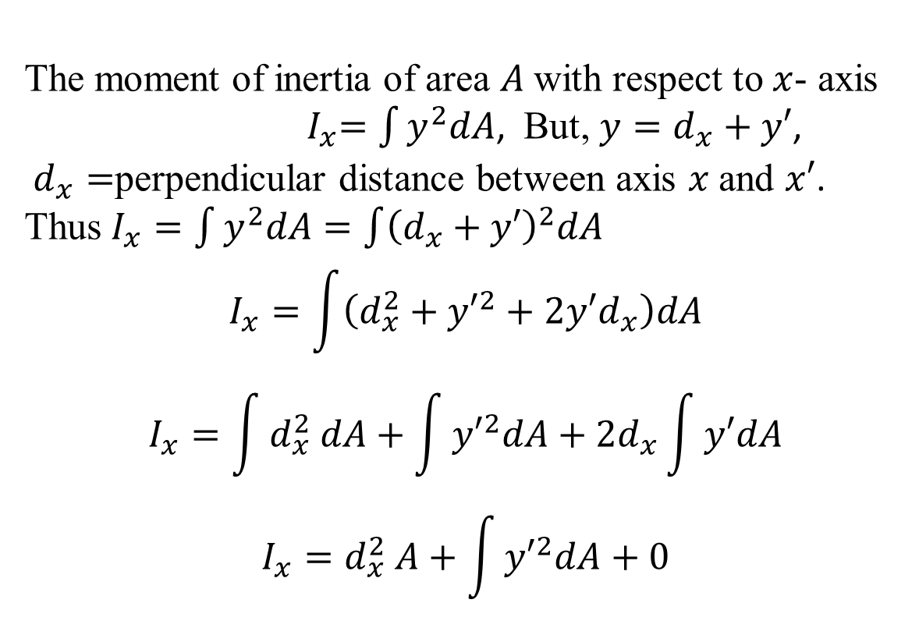
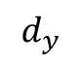

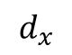
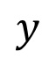
Parallel axis theorem
$$x$$
The moment of inertia of area $A$with respect to $x$- axis ${ I}_{x}=\int{y^{2}dA}$, But, $y=d_{x}+y′$,
$d_{x}=$perpendicular distance between axis $x$ and $x′$.
Thus $I_{x}=\int{y^{2}dA}=\int{{\left(d_{x}+y′\right)}^{2}dA}$
$$I_{x}=\int{\left(d_{x}^{2}+{y′}^{2}+2y′d_{x}\right)dA}$$
$$I_{x}=\int{d_{x}^{2} dA}+\int{{y′}^{2}dA}+{2d}_{x}\int{y′dA}$$
$$I_{x}=d_{x}^{2} A+\int{{y′}^{2}dA}+0$$
$$y$$
$$d_{y}$$
$$y′$$
$$dA$$
$$x′$$
$$A$$
$$O$$
$$y′$$
$$x′$$
$$y$$
$$d_{x}$$
$$d$$
$$x$$
. The term $\int{y′dA}$, represents the first moment of inertia of area $A$ about its own centroidal axis $x′$, and is equal to zero. $I_{x}=\int{{y′}^{2}dA}+d_{x}^{2} A$ or $I_{x}=I_{x′}+A d_{x}^{2}$

Slide 7
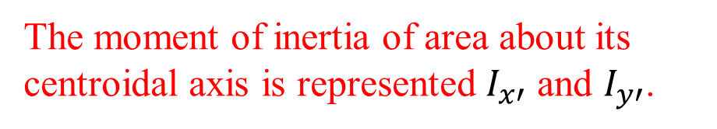
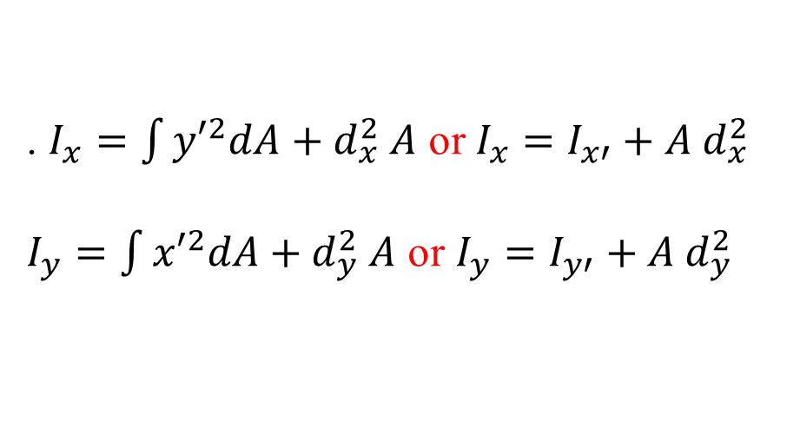
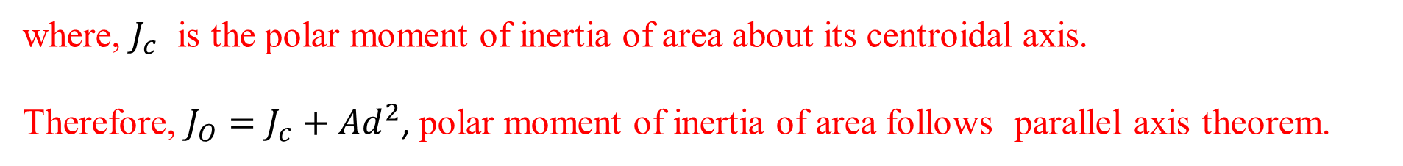
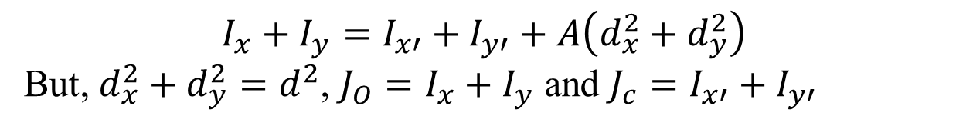
Parallel axis theorem
. $I_{x}=\int{{y′}^{2}dA}+d_{x}^{2} A$ or $I_{x}=I_{x′}+A d_{x}^{2}$
$I_{y}=\int{{x′}^{2}dA}+d_{y}^{2} A$ or $I_{y}=I_{y′}+A d_{y}^{2}$
The moment of inertia of area about its centroidal axis is represented $I_{x′}$ and $I_{y′}$.
The moment of inertia of area with respect to any axis in its plane is equal to the moment of inertia of the area with respect to a parallel centroidal axis plus the product of the area and the square of the distance between the two axis.
$$I_{x}+I_{y}=I_{x′}+I_{y′}+A\left(d_{x}^{2}+d_{y}^{2}\right)$$
But, $d_{x}^{2}+d_{y}^{2}=d^{2}$, $J_{O}=I_{x}+I_{y}$ and $J_{c}=I_{x′}+I_{y′}$
where, $J_{c}$ is the polar moment of inertia of area about its centroidal axis.
Therefore, $J_{O}=J_{c}+Ad^{2}$, polar moment of inertia of area follows parallel axis theorem.

Slide 8
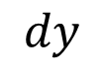
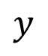
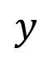
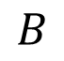
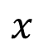






Problem 1
$$y$$
Find the moment of inertia of a rectangular cross section about its centroidal axis. Also, find its moment of inertia about its base $AB$.
$$dA$$
$$dy$$
$$y$$
$$c$$
$$h$$
$$x$$
$$A$$
$$B$$
$$b$$

Slide 9










Problem 2
Determine the moment of inertia of a triangle about its base $AB$ and about its centroidal axis.
$$y$$
$$h−y$$
$$h$$
$$dA$$
$$dy$$
$$l$$
$$y$$
$$A$$
$$B$$
$$x$$
$$b$$

Slide 10









Problem 3
Calculate the moment of inertia of the shaded area about the $x$-axis. The equation of curve $OA$ is given by $x=ky^{2}$.
$$y$$
$$a$$
$$B$$
$$A$$
$$x$$
$$a$$
$$dA$$
$$dy$$
$$y$$
$$x=ky^{2}$$
$$o$$
$$x$$

Slide 11
Problem 3
Calculate the moment of inertia of the shaded area about the $x$-axis. The equation of curve $OA$ is given by $x=ky^{2}$.
$$y$$
$$a$$
$$B$$
$$A$$
$$x$$
$$a$$
$$dA$$
$$dy$$
$$y$$
$$x=ky^{2}$$
$$o$$
$$x$$

Slide 12







Problem 4
Determine the moment of inertia of a circular area about the centroidal axis.
$$y$$
$$dA$$
$$r$$
$$dθ$$
$$θ$$
$$dr$$
$$x$$

Slide 13


Problem 5
Determine the moment of inertia of a hollow circular area about the centroidal axis.
$$y$$
$$R$$
$$r$$
$$x$$

Slide 14


Problem 6
The homogeneous wire ABC is bent into a circular arc and a straight section as shown and is attached to a hinge at A. Determine the value of $θ$ for which the wire is in equilibrium for the indicated position.

Slide 15

Problem 7
Determine the moment of inertia and radius of gyration of the shaded area with respect to y axis.

Slide 16

Problem 8
Determine the moment of inertia of the shaded area with respect to x axis.

Slide 17

Problem 9
Determine the moment of inertia and radius of gyration of the shaded area with respect to x axis.

Slide 18
Problem 9
Determine the moment of inertia and radius of gyration of the shaded area with respect to x axis.

Slide 19


Moment of inertia of geometric shapes (plane figures)

Slide 20








Moment of inertia of composite sections
$$y$$
$$20$$
$$60$$
$$x$$
$$20$$
$$20$$
$$20$$
$$20$$
Determine the moment of inertia of the shaded area with respect to the x axis.

Slide 21





Moment of inertia of composite sections
$$y$$
$$20$$
$$150$$
$$x$$
$$20$$
$$120$$
Determine the moment of inertia of area of L section about its centroidal x- axis and y axis.

Slide 22


Moment of inertia of composite sections
Determine the moment of inertia of the shaded area with respect to the x axis.

Slide 23
Moment of Inertia of composite sections

Slide 24



Moment of Inertia of a simple mass
Angular acceleration about the axis AA’ of the small mass Δm due to the application of a couple is proportional to r²Δm. r²Δm = moment of inertia of the mass Δm with respect to the axis AA’
For a body of mass m the resistance to rotation about the axis AA’ is
The radius of gyration for a concentrated mass with equivalent mass moment of inertia is

Slide 25

Moment of Inertia of mass
Moment of inertia with respect to the y coordinate axis is
Similarly, for the moment of inertia with respect to the x and z axes,
In SI units,
In U.S. customary units,

Slide 26


Parallel axis theorem
Generalizing for any axis AA’ and a parallel centroidal axis,

Slide 27



Moment of inertia of thin plate
For a thin plate of uniform thickness t and homogeneous material of density ρ, the mass moment of inertia with respect to axis AA’ contained in the plate is
Similarly, for perpendicular axis BB’ which is also contained in the plate,
For the axis CC’ which is perpendicular to the plate,

Slide 28


Moment of inertia of thin plate
For the principal centroidal axes on a rectangular plate,
For centroidal axes on a circular plate,

Slide 29

Moment of inertia of 3-D body by method of integration
Moment of inertia of a homogeneous body is obtained from double or triple integrations of the form
For bodies with two planes of symmetry, the moment of inertia may be obtained from a single integration by choosing thin slabs perpendicular to the planes of symmetry for dm.
The moment of inertia with respect to a particular axis for a composite body may be obtained by adding the moments of inertia with respect to the same axis of the components.

Slide 30


Moment of inertia of common geometric shape

Slide 31


Moment of inertia of composite shape
Determine the moments of inertia of the steel forging with respect to the xyz coordinate axes, knowing that the specific weight of steel is 490 lb/ft³.

Slide 32




Sample Problem 8
MODELING and ANALYSIS:
Compute the moments of inertia of each component with respect to the xyz axes.
Cylinder (a=1 in., L=3 in., $\overline{x}$=2.5 in. and $\overline{y}$=2.0 in.)
$$I_{x}=\frac{1}{2}ma^{2}+m\left[{\overline{y}}^{2}\right]$$
$$=\frac{1}{2}\left(0.0829\right){\left(\frac{1}{12}\right)}^{2}+\left(0.0829\right)\left[{\left(\frac{2}{12}\right)}^{2}\right]$$
$$=2.59×{10}^{−3}lb.ft.s^{2}$$
$$I_{y}=\frac{1}{12}m\left[3a^{2}+L^{2}\right]+m\left[{\overline{x}}^{2}\right]$$
$$=\frac{1}{12}\left(0.0829\right)\left[3{\left(\frac{1}{12}\right)}^{2}+{\left(\frac{3}{12}\right)}^{2}\right]+\left(0.0829\right)\left[{\left(\frac{2.5}{12}\right)}^{2}\right]$$
$$=4.17×{10}^{−3}lb.ft.s^{2}$$
$$I_{z}=\frac{1}{12}m\left[3a^{2}+L^{2}\right]+m\left[{\overline{x}}^{2}+{\overline{y}}^{2}\right]$$
$$=\frac{1}{12}\left(0.0829\right)\left[3{\left(\frac{1}{12}\right)}^{2}+{\left(\frac{3}{12}\right)}^{2}\right]+\left(0.0829\right)\left[{\left(\frac{2.5}{12}\right)}^{2}+{\left(\frac{2}{12}\right)}^{2}\right]$$
$$=6.48×{10}^{−3}lb.ft.s^{2}$$

Slide 33
Sample Problem 8
prism (a = 2 in., b = 6 in., c = 2 in.):
Add the moments of inertia from the components to determine the total moments of inertia.

Slide 34
Acknowledgement
NPTEL lectures on Engineering Mechanics
Beer & Johnston, Vector Mechanics for Engineers
Meriam & Kraige, Engineering Mechanics
Problems taken from internet sources
Timoshenko & Young, Engineering Mechanics
S S Rattan, Theory of Machine

